Slide 1

Module 1.3 Hardware

Slide 2
Contents
Introduction
Input
Output
Storage
Health and environmental issues
Test and improve
Written module activity

Slide 3
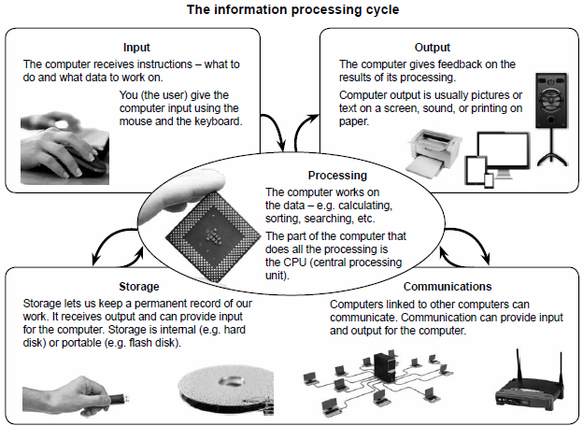
Introduction

Slide 4
Input – data and instructions
Instructions can be:
Program
Set of instructions loaded into memory when you run the program
Commands
Given by user (e.g. you click on the Font Size command)
User responses
To a question ‘asked’ by a program

Slide 5
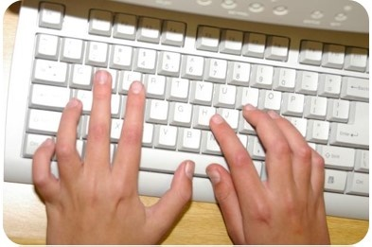
Input – the keyboard
Keyboard is the most commonly used input device.
Useful shortcuts:
F1 Help
Esc Cancel choices
Windows key (),<E> File Explorer
<><D> Desktop

Slide 6
Input – the keyboard
Useful shortcut: Print Screen key
To take a ‘photo’ of everything that is displayed on the screen at that moment
‘Screen capture’ is copied as an image to the clipboard
Clipboard
an area in memory where text and other objects that have been copied are temporarily stored

Slide 7
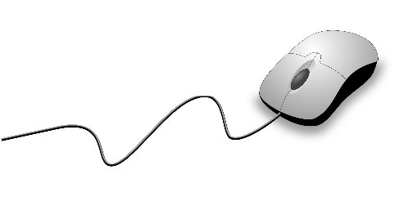
Input – the mouse
Mouse action | Use
Click | Select an option or an object.
Double-click | Start a program or open a file or folder.
Right-click | Open a pop-up menu that gives you options or actions.
Drag | Select and drag an object.
Scroll | Use the mouse wheel to scroll in lists, long documents or web pages.
Keyboard and mouse combinations | Pressing and holding Shift, Alt and Ctrl can change the meaning of a mouse click.

Slide 8
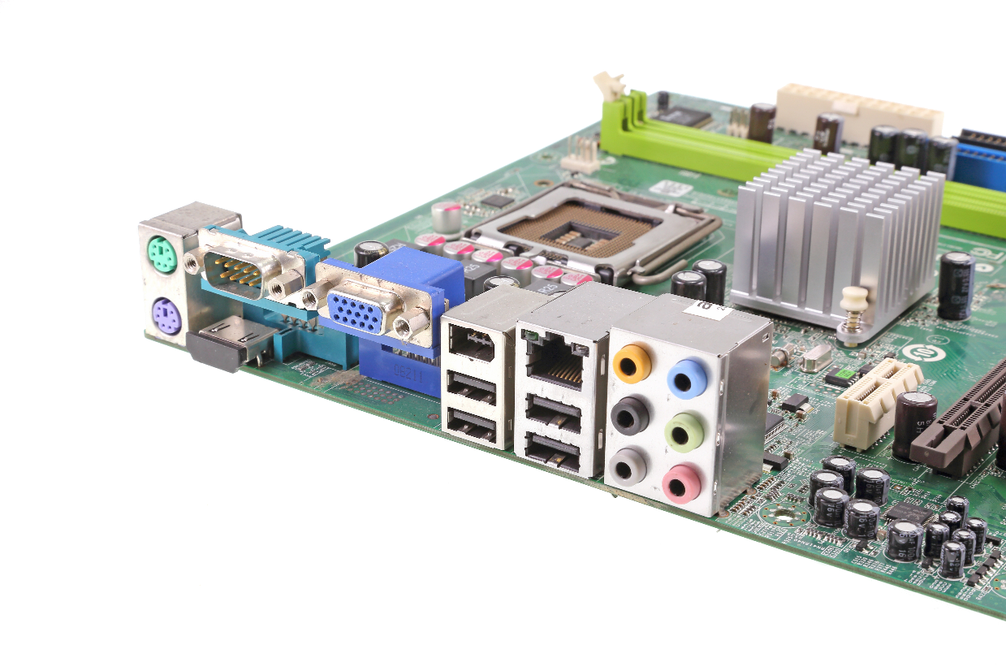
Input – connecting devices
Ports: sockets used to connect peripherals to the computer
Plug-and-play: operating system automatically detects and configures a device plugged into the computer, so the device can be used almost immediately.

Slide 9
Input – Wireless mouse & keyboard
Use short range radio waves (usually Bluetooth) to communicate with the computer.
Advantages of wireless devices
Less clutter (as no cables)
Wider range of movement
Disadvantages / limitations of wireless devices
Require batteries (to send wireless signal)
Slightly more expensive than wired devices
Can easily be removed, so easily stolen
Can sometimes be interference with the wireless signal
Notes:
A wireless adapter has to be attached to the computer to receive signals from the device. All wireless devices need power in order to transmit a signal and so they have to contain some form of battery.

Slide 10
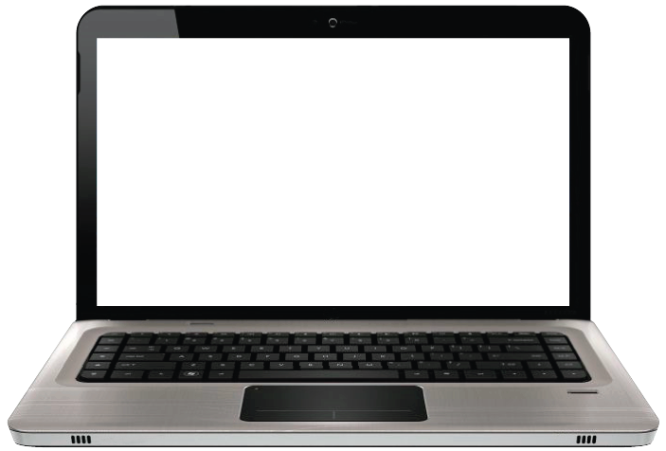
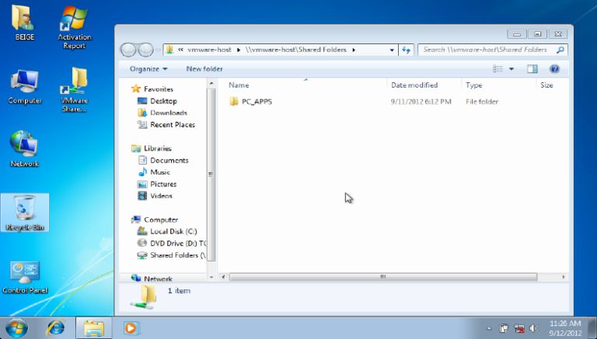
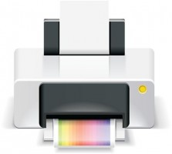
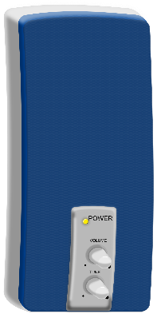
Output
What the computer produces as the results of its processing

Slide 11
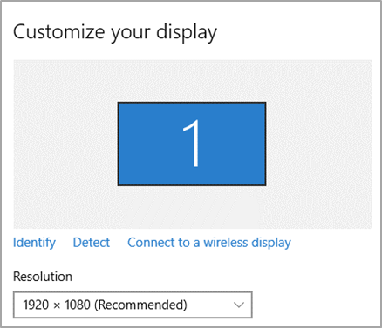
Output – Monitor
Size
Resolution
Measured diagonally in inches, from one corner to the other
Number of pixels (small dots) used to form the screen image

Slide 12
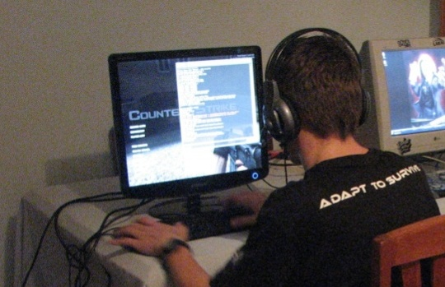
Output – Monitor
Graphics card
Image is generated by specialized circuitry – the graphics card
A separate, high end graphics card is better for graphics intensive tasks such as video editing and games.

Slide 13
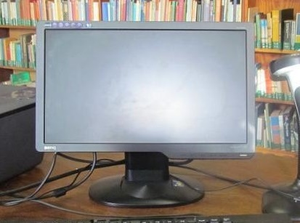
Output – Monitor
Response time
Connecting monitors
The time it takes to change a pixel from one colour to another – measured in milliseconds.
VGA (old standard)
HDMI
DisplayPort
Thunderbolt
USB (for specialised monitor)

Slide 14
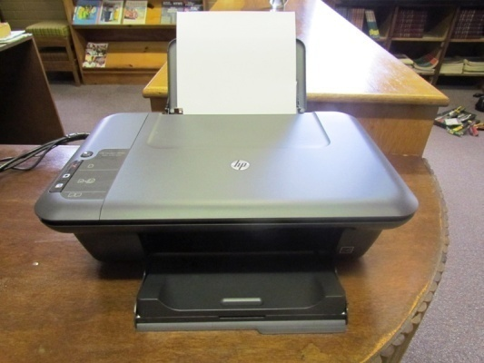
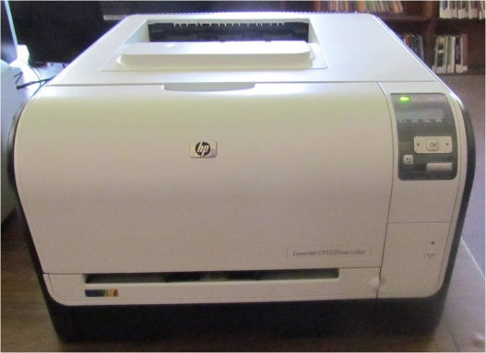
Output – Printers
Inkjet printers
Laser printers
• work like a photo-copier
• more expensive to buy
• cheaper to run when printing large volumes
• faster than inkjet printers
• spray microscopic dots of ink onto
the paper
• relatively cheap to buy
• more expensive to run
• good quality colour prints
• slightly slower than laser printers

Slide 15
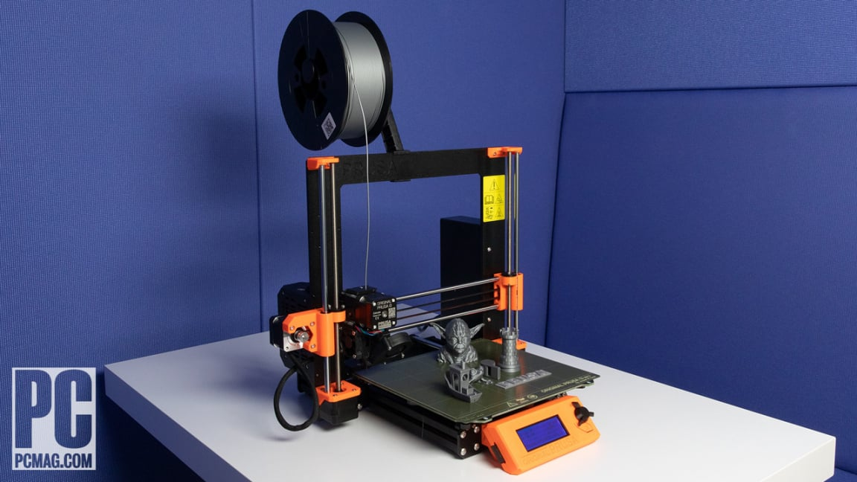
3D Printer

Slide 16
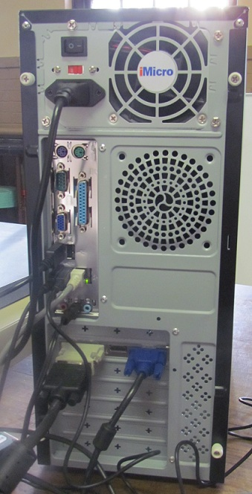
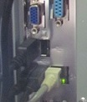
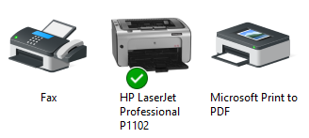

Output – Printers
Connecting and using printers
Printer installation
USB port
Default printer

Slide 17
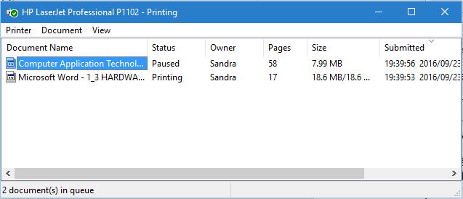
Output – Printers
Printer queues
You can cancel, pause or restart the printing here

Slide 18
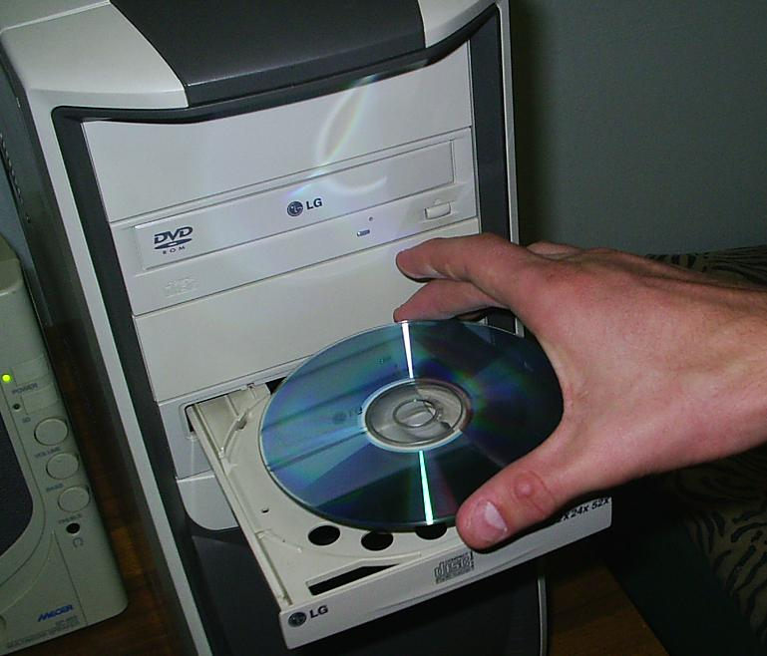
Storage
Storage has a much larger capacity than memory because it has to keep all your data and programs – even the ones you are not using right now.
Storage device
(CD/DVD-drive)
Storage medium (CD/DVD)

Slide 19
Storage
4
1 byte
d
%
Storage capacities
1 kilobyte (KB) = 1024 bytes
1 megabyte (MB) = 1024 KB
1 gigabyte (GB) = 1024 MB
1 terabyte (TB) = 1024 GB

Slide 20
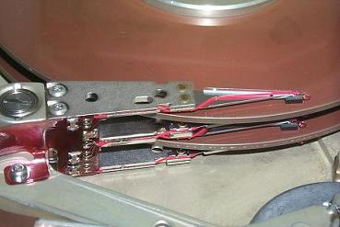
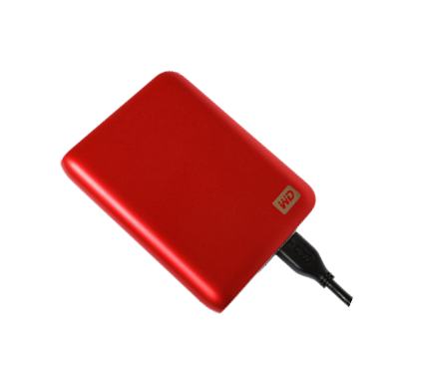
Storage – Hard drives
Hard drive in case:
stores all programs and data
measured in GB or TB
External/portable hard drive:
USB connected
gets power from PC

Slide 21
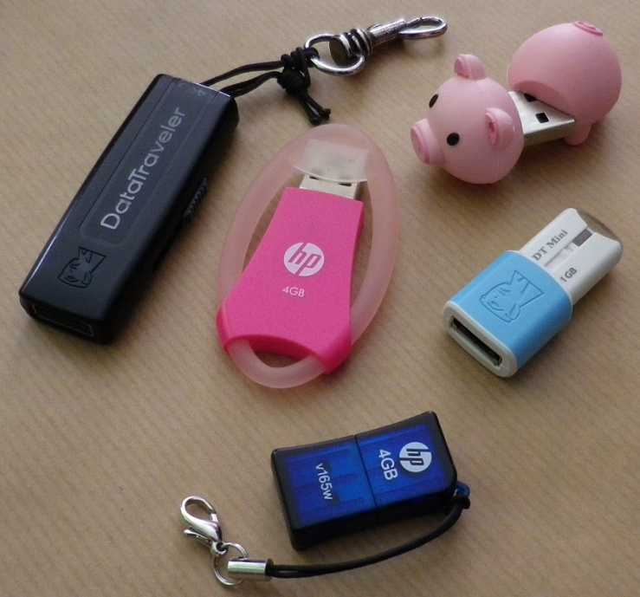
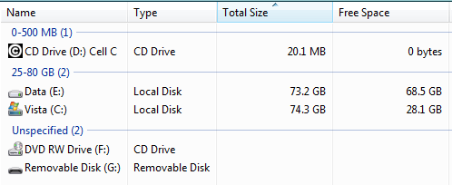
Storage – Flash drives
Use electronic memory to store data; powered via USB port
Simply plug into USB port
Listed as ‘Removable Disk’

Slide 22
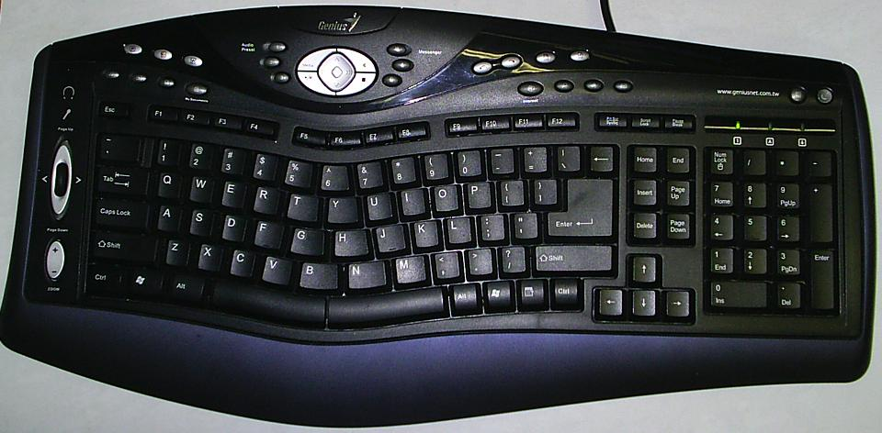
Health and environmental issues
Health concerns
RSI: Repetitive Strain Injury
Using ergonomically designed keyboards can help prevent RSI
Ergonomics – the study and design of the workplace and the equipment used in the workplace for the comfort and safety of people in their work environments.

Slide 23
Health and environmental issues
Health tips for using computers
Use ergonomically designed equipment
Sit correctly
Adjust height of seat and table
Lighting must be adequate
Ventilation / air circulation must be adequate
Mouse and keyboard must be in easy reach
Monitor at correct level and distance from eyes
Turn eyes away from monitor every now and then
Take regular breaks

Slide 24
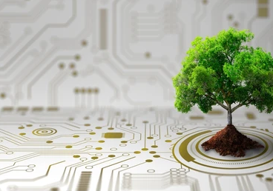
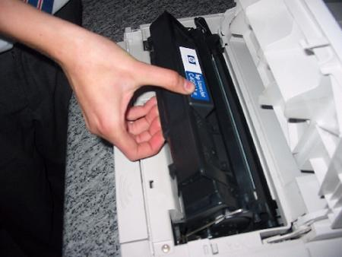
Health and environmental issues
Green computing
Switch off computers and devices you are not using
Avoid wasting paper – proofread before you print, print ‘2 on 1’, etc.
Try to repair or upgrade old or broken hardware
Recycle or return used ink and toner cartridges
Consider refilling and reusing ink and toner cartridges

Slide 25
Test and improve
Summary – concepts, terms and tips
Input
Keyboard
Mouse
Output
Monitor
Printer
Storage
Hard drive
Flash drive
Connecting devices
Wireless mouse and keyboard
Health and environmental issues
Health concerns
Green computing

Slide 26
Written module Activity

Slide 27
Note:
Question 8 – meaning of the word ‘specification’:
The exact description of an item or the parts it is made up of.

